Slide 1
Troubleshooting Fundamentals: Time Tested Techniques

Slide 2
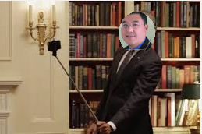
Troubleshooting Fundamentals: Time Tested Techniques

Slide 3
Hansang Bae, Packet Challenge Awarder
hansang.bae@riverbed.com
hansang@gmail.com
youtube.com/hansangb
Packet traces are available for download:
https://box.com/Sharkfest2015Public
Random fact: First protocol analyzer: Spider Analyzer from UK

