Slide 1
Introduction to Wireshark Making Sense of the Matrix

Slide 2
Presenter – Chris Greer
Packet Pioneer LLC
Network Analyst - WCNA
Training and Professional Services
Network and application performance analysis
www.lovemytool.com
www.brighttalk.com

Slide 3
Housekeeping
You can follow along with your own copy of Wireshark – www.wireshark.org
Download the trace files we will be using at:
www.bit.ly/packetanalysis

Slide 4
Why packets?
Packets Don’t Lie
We can’t fix what we can’t see
Traffic and Protocol Analysis is the most detailed troubleshooting method

Slide 5
Packet Collection
Common capture methods:
Span/Mirror
Tap / Aggregation Tap
Directly on the client

Slide 6
Getting in the path: Span/Mirror
Copies selected ports, hosts, vlans, or traffic patterns to a monitor port

Slide 7
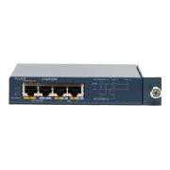
Getting in the path: Taps
A tap is the best means to capture packets
Directly monitors the connection inline

Slide 8
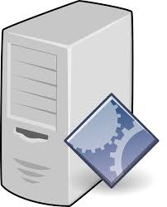
Getting in the path: Aggregation TAP
Tap Output
SPAN Output

Slide 9
Capturing directly from client
The protocol analyzer can be installed directly on the client – but there are several negatives to this

Slide 10
Problems aren’t what they used to be

Slide 11
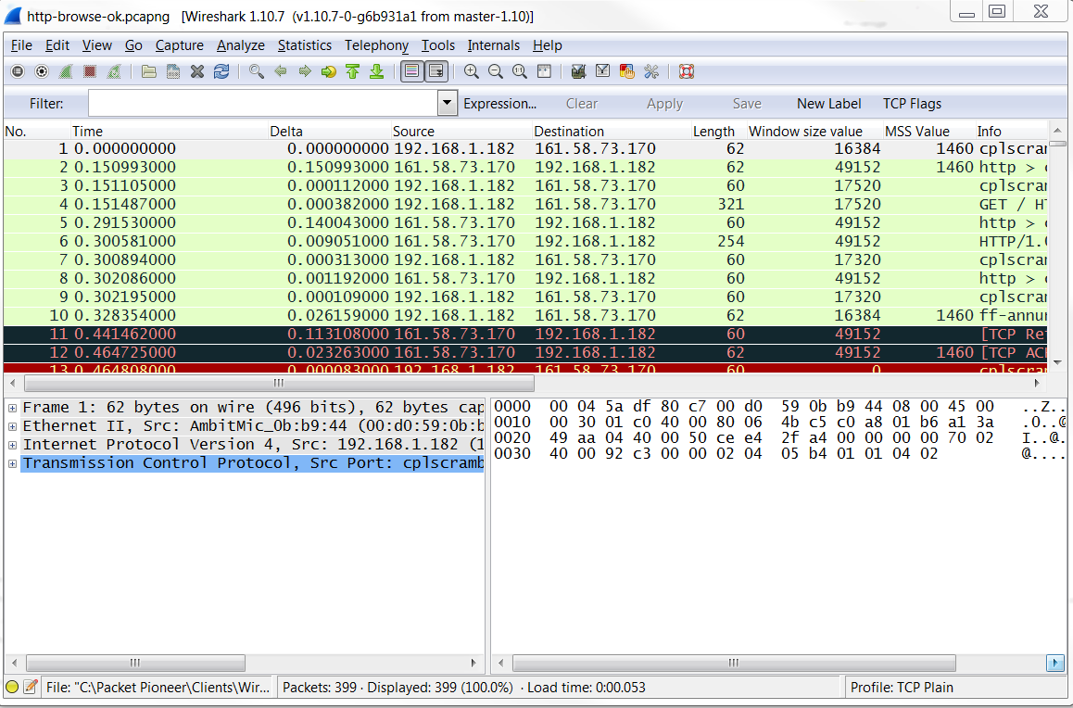
Quick, find the problem!

Slide 12
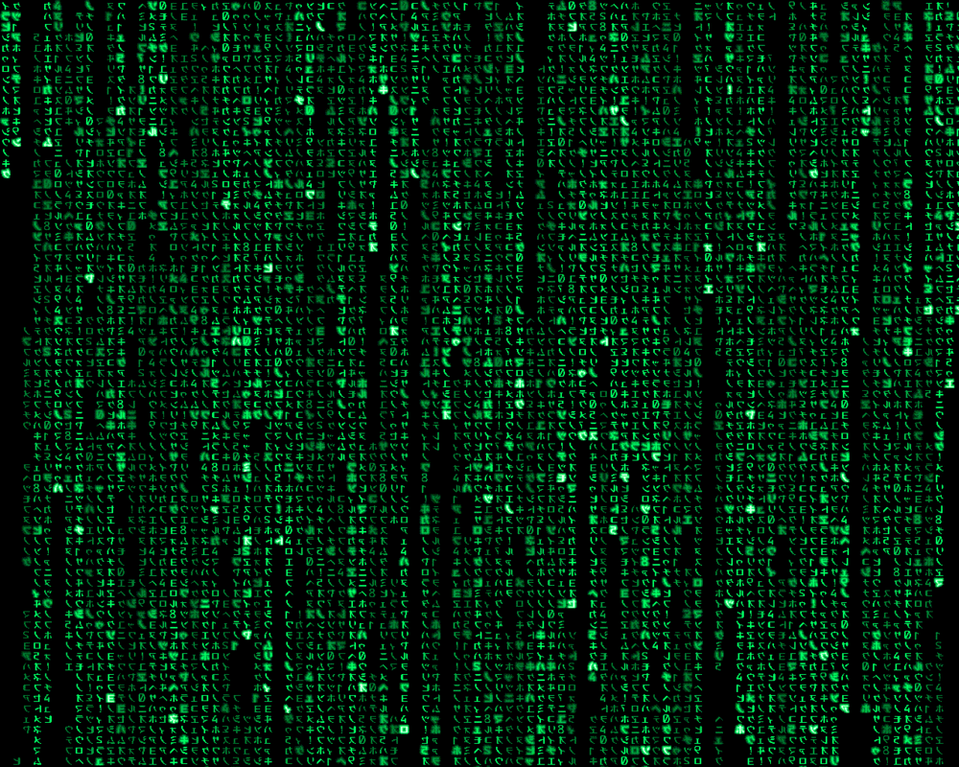
But it looks like this…

Slide 13
Step 1: Setup your columns
Open HTTP-CNN.pcap

Slide 14
Step 2: Configure Display Filters
Open HTTP-CNN.pcap

Slide 15
Step 3: Find Top Talkers

Slide 16
Step 4: Know What to Ignore
Open Slow Web Application.pcap
HTTP-CNN.pcap
Not filters.

Slide 17
Thanks!
Enjoy the rest of Sharkfest 2015!

