Slide 1
A18 – DEDUPING PACKET CAPTURE FILES AT LAYER 3 Using Wiretap to Create a Custom De-duping Application
Robert Bullen
Blue Cross Blue Shield MN

Slide 2
Agenda
Of General Interest
Define Layer 2 and Layer 3 duplicates
Explain when and why duplicates are captured
Cover existing deduping solutions
Introduce a new solution
Show demos throughout
Of Interest to Developers
Outline the new solution’s architecture
Explain how Wiretap was leveraged
Show code samples
Model the new solution’s duplicate detection algorithm

Slide 3
DEALING WITH DUPLICATE PACKETS

Slide 4
Definitions
Layer 2 duplicates are packets that are byte-for-byte identical
Layer 3 duplicates are packets that have variations in Layer 2 encapsulation, and even slight variations in Layer 3 headers, as they are routed through a network
MAC addresses and VLAN tags will change
The IP TTL field will decrement

Slide 5
Problem Statement
Duplicate packets can be found in trace files in the following scenarios
When SPANing VLANs
When SPAN bugs exist in routers/switches
When aggregating multiple capture points by way of
Packet brokers
Mining multiple ports of a sniffer
Manually merging trace files
Analyzing trace files containing duplicate packets is difficult for both tools and their users
Tools inflate error counts, which can cause incorrect or misleading diagnoses; e.g. Wireshark will flag TCP duplicate segments as retransmissions or out-of-order
Tool features can fail in the face of duplicates; e.g. Wireshark’s SSL decryption
Users can get confused following a packet flow—it’s hard enough as it is!
Notes:
We’re seeing a proliferation of monitoring taps in packet broker environments. For example, taps above and below a firewall. In fact, at Blue Cross we have a best practice to tap inline, rule-based appliances, which is any device that can potentially introduce latency or willingly drop packets. This allows us to confidently and conclusively perform analysis on such devices.

Slide 6
Scenario 1—Intermittent Packet Loss Between Firewall and Load Balancer
Load Balancer
Mirror
GET
Tap
Web App Firewall
Tap
Firewall
Packet Broker
Sniffer
Web Server
Notes:
As you know, the network is the first to be blamed when something goes wrong. Well, the first thing the network team does is turn around and blame security. So this problem came to us as “what’s wrong with the WAF?”
We were able to use a simple test of an HTTP GET to reproduce the problem (intermittently)
A quick look at the packets revealed that the WAF was not dropping packets at all, yet the LB was behaving as if it wasn’t receiving them, causing retransmissions.
This is a fiber connection between the WAF and the LB, with no interface errors on either side. So its pretty unlikely there are physical layer issues.
So we added in the LB’s mirror port to test that it was receiving everything that it should.

Slide 7
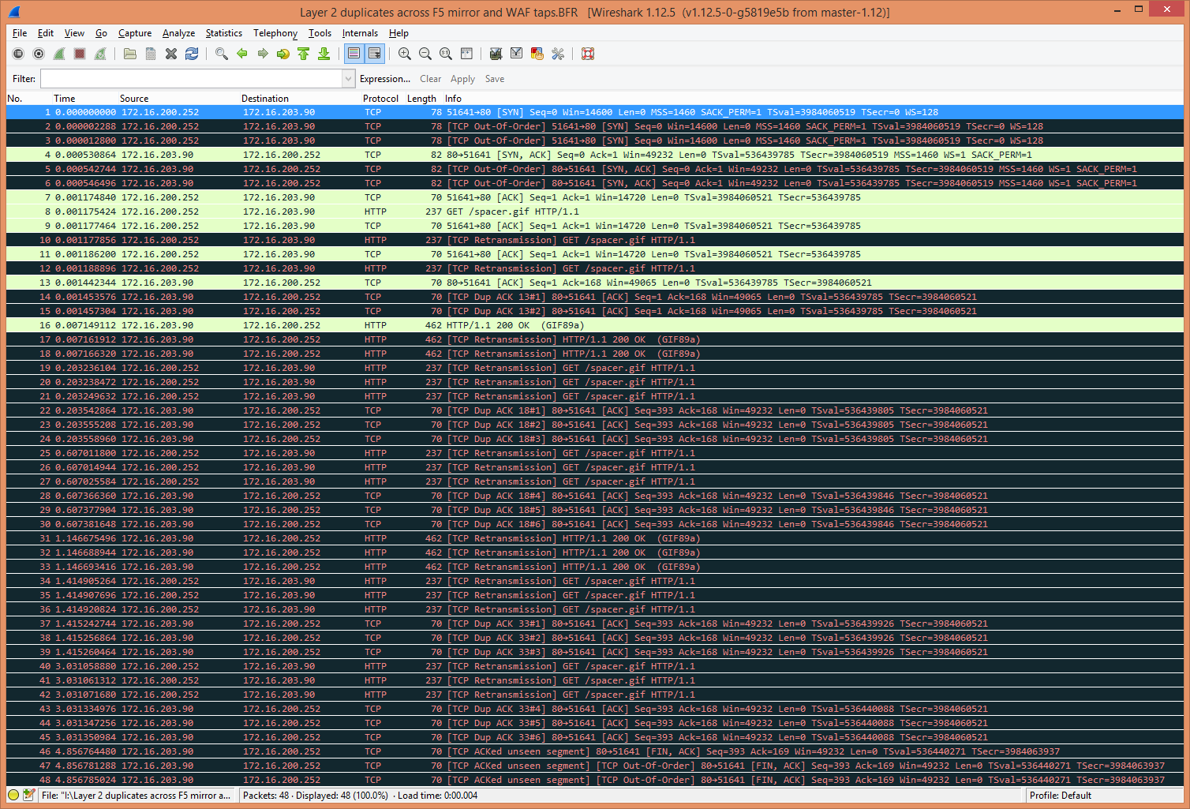
Demo 1—Wireshark
Notes:
And this is what the trace looks like. Look at all those retransmissions that Wireshark calls to our attention. But here’s the thing: some of the packets are real retransmissions and some are the result of Wireshark being confused by duplicates. There are a couple tweaks we can make in order to focus on the patterns:
Turn off coloring
Show an identifying column like TCP SEQ or IP ID

Slide 8
Existing Solutions
Avoid duplicates by crafting packet captures carefully
Isolate packet sources (not possible in retrospective analysis)
Be precise with packet broker/sniffer filters on MAC addresses and VLAN tags in addition to IP addresses
Sniffer on-board deduplication
Layer 2 deduplication only (byte-for-byte)
Potentially a bad idea for continuous capture jobs because those captures would no longer accurately reflect the real world
Packet broker on-board deduplication
Some have configurable Layer 3 deduplication
Potentially an extra license cost
More of a point solution, not general purpose
Probably a good idea for monitoring appliances (APM or security)
Potentially a bad idea for continuous capture jobs on sniffers because those captures would no longer accurately reflect the real world
Editcap
Part of Wireshark tool suite
Layer 2 deduplication only (byte-for-byte)

Slide 9
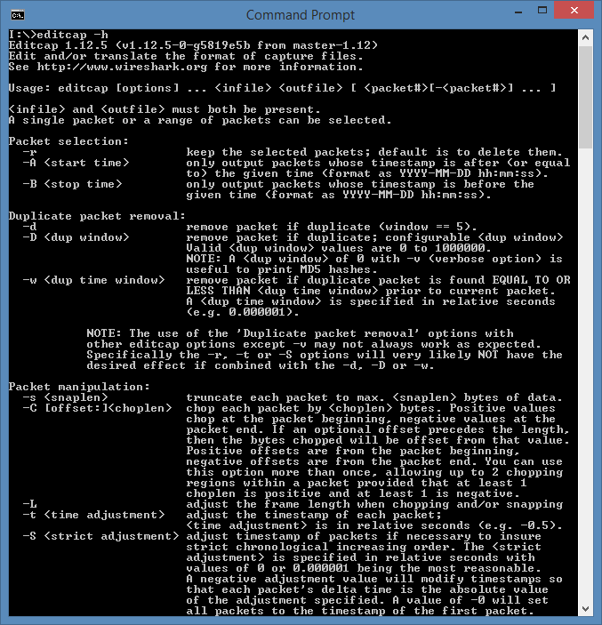
Demo 2—Editcap

Slide 10
Duplicate Detection Queuing Modes
Frame Queuing
Pro: Fixed frame count means static RAM usage
Time Queuing
Pro: Duplicate detection unaffected by burstiness
Con: Duplicate detection depends on burstiness
Con: Variable frame count means dynamic RAM usage
Time queueing oftentimes yields more intuitive results
Frame queueing can be handy when it is desirable to restrict deduplication to just one or two packets away

Slide 11
Scenario 2—Layer 2 & Layer 3 Duplicates with Differing MAC Addresses and VLAN Tags
VLAN
200
Load Balancer
Mirror
Tap
Web App Firewall
Tap
VLAN
203
Firewall
Tap
Packet Broker
Sniffer
Web Server
Web Server
Notes:
The first scenario was ever so slightly contrived for the sake of simplicity.
The firewall is bridging the two VLANs that you see here and we actually had one more capture point on the firewall. How many duplicates will we see now? How many Layer 2 and how many
Remembering that it’s a one-legged firewall, we will have 5 duplicates. Why would I willingly go against my own recommendation to craft captures carefully in the first place?
It’s like in photography—there are rules of good composition. It is recommended that you know the rules so that when you are ready, you know why you are intentionally breaking them.
The same held true here; I knew what I was getting into and I wanted the duplicates. Remember that this issue was intermittent. I wanted to be able to look at everything between the firewall and load balancer for a single occurrence of the failure, rather than work my way through this one capture point and one failure at a time.

Slide 12
Demo 3—Wireshark, Editcap, Wireshark
Notes:
Do a display filter to show that you can reduce the trace to just one capture point, but that the TCP diagnostics still remain

Slide 13
INTRODUCING SUPER DEDUPER
twitter: @deduper
email: deduper@robertbullen.com
download: http://goo.gl/Yy49W3

Slide 14
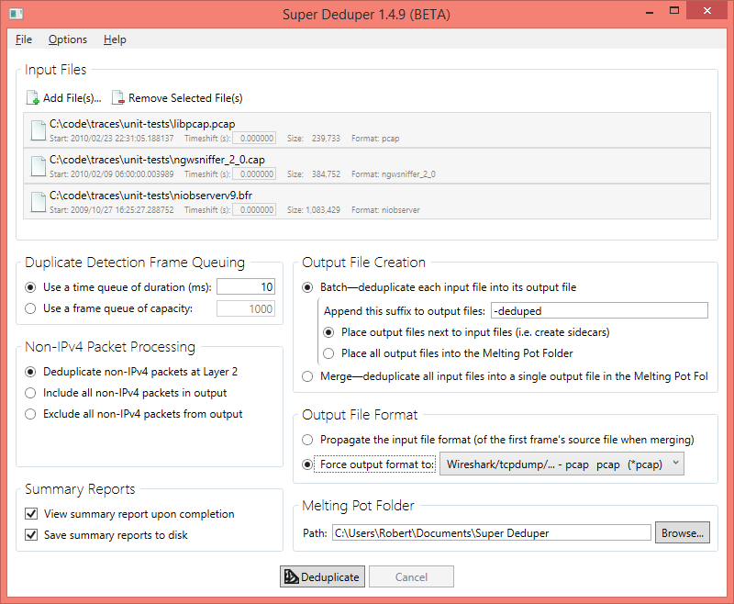
Super Deduper’s Features
Presents a GUI that reads and writes all Ethernet trace file formats supported by Wireshark
Accepts files via drag & drop
Propagates the input file’s format to, or forces a chosen format on, the output file
Detects duplicates in two queuing modes
Time queuing—detects duplicates up to a maximum delta time
Frame queuing—detects duplicates up to a maximum separation by frame count
Deduplicates IPv4 packets by ignoring layer 2 differences in frames (e.g. MAC addresses, VLAN tags)
Supports optionally deduping non-IPv4 frames byte-for-byte at layer 2, just like editcap
Processes multiple files in two modes
Batch mode dedupes each input file independently to its own output file
Merge mode aggregates all input files while deduping and merges them into a single output file
Shifts timestamps on-the-fly on a per-file basis
Generates an HTML summary with detailed logs of per-packet handling

Slide 15
Demo 4—Super Deduper
Notes:
Open trace-03, set to Batch mode in the Meltiing Pot folder and dedupe it, then execute demo-04-wireshark.bat
Open the trace-04 set of files

Slide 16
Super Deduper’s Current Limitations
Outputs only the first duplicate
Cannot specify the n^{th} duplicate
Cannot select duplicates from a specific segment (based on MAC addresses or VLAN tags)
IPv4 duplicate determination is based solely on the IP Source, Destination, ID, and Payload
Cannot take TTL, options, etc. into account
IPv6 is not given special consideration like IPv4
Currently processed like any other non-IPv4 frame

Slide 17
Use Caution When Deduping
Deduping can mask problems like packet storms
Deduping can mask legitimate retransmissions that are byte-for-byte identical to the original segment (but shouldn’t be)
Deduping packets from segments with nontrivial latency between them can result in misleading timings
When slicing/truncating of packets has taken place, and there are layer 3 duplicates of differing layer 2 lengths greater than the slice limit, they will not be detected
Notes:
Any time you use a tool you have to be careful. Or as my mentor Scott Haugdahl puts it, “You have to be an expert to use an expert system.” And by that he means know what traffic is going in to the expert and understand why it is saying what its saying—don’t just blindly believe it because that’ll get you in trouble. Editcap and Super Deduper are by no means expert systems, but you should understand why you have duplicate packets and compare their output to what you expect. Because…

Slide 18
INFORMATION FOR DEVELOPERS

Slide 19
Super Deduper’s Architecture
Wiretap
C API
Deduplication Logic
Model
UI Interaction Logic
View Models
UI Presentation
WPF Views
Wiretap .NET Wrapper
Object-oriented Interop, Timeshifting & Merging

Slide 20
Wiretap Library Dependency Tree
wiretap-2.0.0
libglib-2.0.0
libintl-8
libgmodule-2.0.0
libwsutil
libgpg-error6-2.0.0
zlib1
libgcyrpt-20
msvcrt

Slide 21
Wiretap Wish List
Improve API documentation
Design Wiretap as a reusable module
Lessen dependencies on external modules, mainly the libwsutil branch
Improve API consistency
Some functions return strings that are dynamic and must be freed or a memory leak will occur, while others return strings are static and must not be freed. There is no way to tell how a string should be handled without diving into the code.
Use Glib types everywhere
Improve source code organization
Nearly the entire API is declared in wtap.h, but some is implemented in wtap.c and some in file_access.c
The API should also be organized into logical regions with their own headers and implementation files, much like how each file format is treated

Slide 22
Super Deduper’s Architecture
Wiretap
C API
Deduplication Logic
Model
UI Interaction Logic
View Models
UI Presentation
WPF Views
.NET Wrapper
Object-Oriented Interop, Timeshifting & Merging

Slide 23
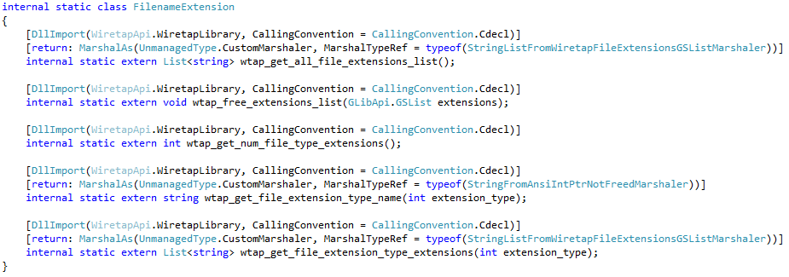
Wiretap API Interop Declarations
Notes:
For better or worse, I implemented it in C#. In fact it targets .NET Framework v4.0, so that is a prerequisite. But .NET 4 was released in 2010 so odds are that it is installed in your Windows client.
Some functions, like the second and third are straightforward to declare, especially when they accept and return blittable types
Others, like the first, require custom marshalling. As you can see when comparing to the original C declaration, that function returns a pointer to a Glib singly-linked list. .NET doesn’t understand that native data structure. So I had to write a custom marshaller that converts it into
If I was to start over today, I would have to consider using C++ & Qt for portability. But I started Super Deduper back in the Wireshark v1.6 era.
This was before the C++11 standard was formulated that modernized the language considerably
I was aware of Qt, in fact I had even done some light Qt development previously. But at the time it didn’t have a great designer experience and there was no foreshadowing of Wireshark’s adoption of it
There was no way I was going to adopt GTK
The Windows vs. Mac OS X decision was simpler back then. Especially considering that I was supporting an Enterprise environment
WPF was the Windows GUI hotness at the time
But now the C#/.NET landscape has changed recently, too. With Microsoft open sourcing the entire framework, and Xamarin having a cross-platform UI toolkit, a Mac port is not out of the question

Slide 24
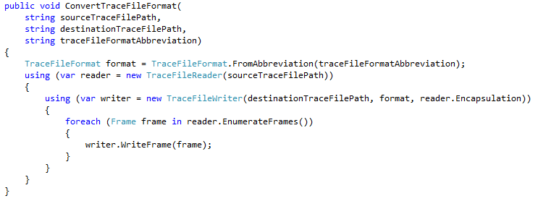
Sample C# Method Using Wiretap .NET Wrapper

Slide 25
Super Deduper’s Architecture
Wiretap
C API
Deduplication Logic
Model
UI Interaction Logic
View Models
UI Presentation
WPF Views
Wiretap .NET Wrapper
Object-oriented Interop, Timeshifting & Merging

Slide 26
How Duplicate Detection Works
Frame C is read.
Frame C is added to the queue but not the hash table because it isn’t an IPv4 packet with an IP ID.
The queue is searched linearly for a duplicate to Frame C.
Frame C is found to be unique, so it is written to the output file.
Packet D is read and added to the queue.
Packet D is inserted into the hash table also .
There are no other packets having the same IP ID so it must be unique and is written to the output file.
Packet A’ is read and added to the queue.
Packet A’ collides with Packet A in the hash table, and furthermore is a duplicate of Packet A. It is not written to the output file.
The hash table always refers to the most recent instance, so it is updated to point to Packet A’.
Packet A
0
1
2
Packet B
…
Frame C
Packet D
Packet A’
…
65535
Frame Circular Queue
(ring buffer)
Output File
IPv4 Packet Hash Table
(hash function = IP ID)

Slide 27
Future Plans/Ideas
Finish the BETA
Make a Super Deduper command line variant
Fix the slicing limitation
Implement set operations (union, intersection, difference)
Add an editcap mode
Revamp the GUI

Slide 28
THE END

