Slide 1
Art of Packet Analysis

Slide 2
Hansang Bae
hansang.bae@riverbed.com
hansang@gmail.com
youtube.com/hansangb
https://box.com/Sharkfest2015Public

Slide 3
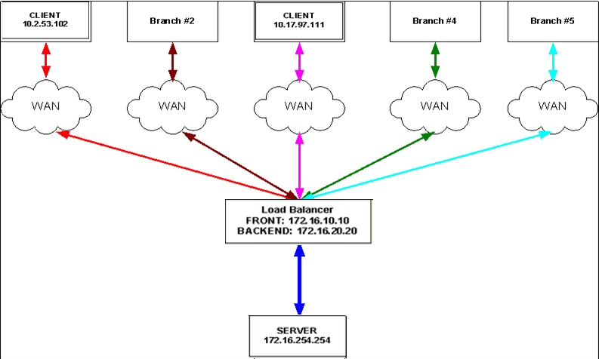

Slide 4
