Slide 1
extcap – Packet Capture

Slide 2
If the packets won’t come to Wireshark
Wireshark will have to come for the packets

Slide 3
Traditional pipes

Slide 4
How does capture work
All capture goes through dumpcap
Interfaces use pcap / pcapng as capture utility
Close of pipe => end of capture
Wireshark asks for the interfaces
Dumpcap lists interfaces
Starts pipes with main Wireshark for data exchange
Read capture data

Slide 5
Pipes to the rescue
dumpcap understands pipes
Easy right?

Slide 6
What can go wrong
Restart / Start / Stop
Broken pipe / Broken rights
Windows
Configuration means restart

Slide 7
Usage Scenarios
Data residing on a different network environment
Data not being „networky“ at all
System events and logs
RF environments

Slide 8
extcap

Slide 9
extcap
external capture interface
First presented at SharkFest US‘13 by Mike Kershaw and Mike Ryan
https://sharkfestus.wireshark.org/sharkfest.13/presentations/NAP-11_Expanding-Wireshark-Beyond-Ethernet-and-Network-Interfaces_Kershaw-Ryan.pdf
Part of Wireshark since 2.0
Mission statement: Utilize the pipe interface and make a nice gui for it

Slide 10
extcap features
Start / Stop / Restart capture from interface
Handle interface configuration
Handle runtime control

Slide 11
Capture
Provide a list of interfaces
Provide a list of Configs
Macbook:extcap rknall$ ./extcap_example.py --extcap-interfaces
extcap {version=1.0}{help=http://www.wireshark.org}{display=Example extcap interface}
interface {value=example1}{display=Example interface 1 for extcap}
interface {value=example2}{display=Example interface 2 for extcap}
Macbook:extcap rknall$ ./extcap_example.py --extcap-interface example1 --extcap-config
arg {number=0}{call=--delay}{display=Time delay}{tooltip=Time delay between packages}{type=integer}{range=1,15}{default=5}
arg {number=1}{call=--message}{display=Message}{tooltip=Package message content}{type=string}{required=true}{placeholder=Please enter a message here ...}
...

Slide 12
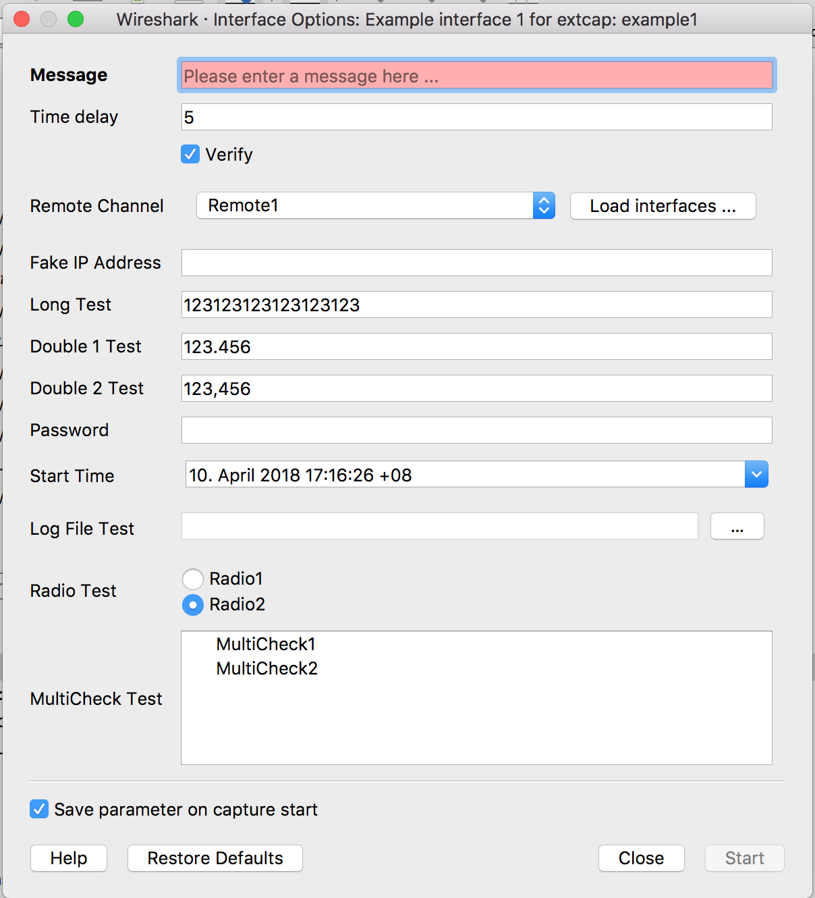
Interface Configuration
Various options
Text, Integer, Bool, IP Addresses, Passwords (hashed), Date/Time, Files, Radio, Dropdown, Multicheck (parent dependency)
Check for Ranges or with RegExp
Mandatory fields

Slide 13
Interface Configuration (2)
Parameter get‘s stored
Restore to defaults possible
Help provided via website or local link

Slide 14
Interface configuration (3)
Reload functionality (WS 3.0)
Reload calls extcap with all filled out parameters

Slide 15
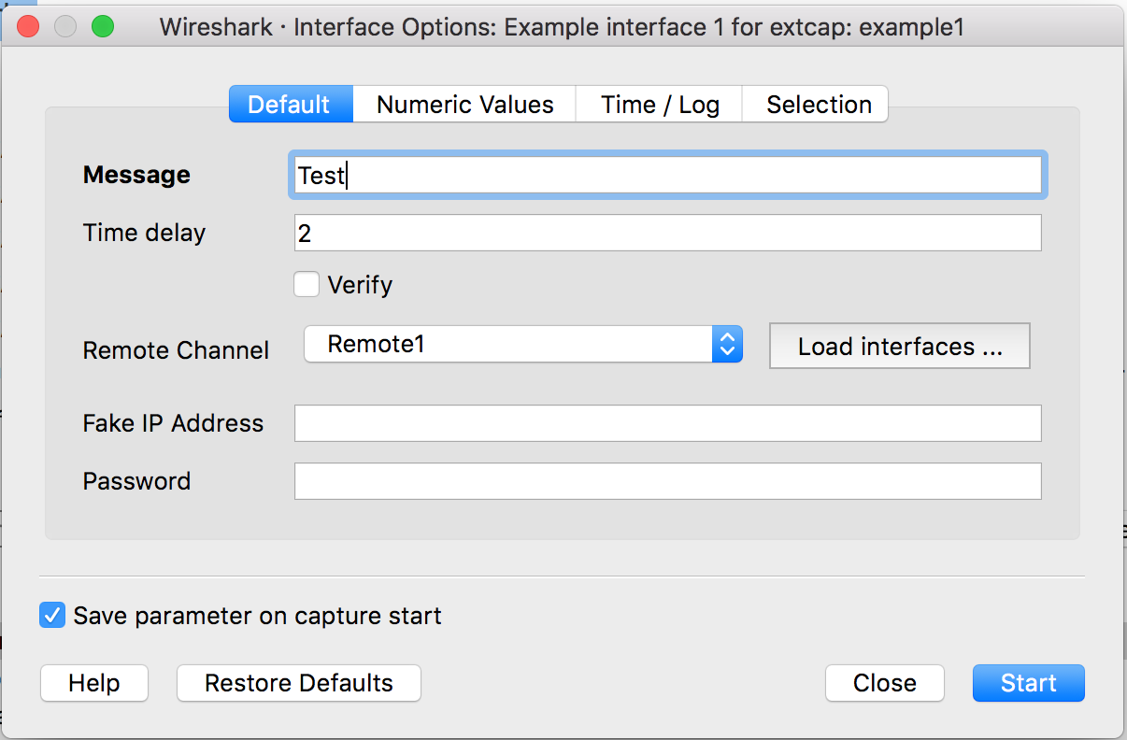
Interface configuration (4)
New grouping
Makes for easier managment

Slide 16
Control while running
Create a toolbar for your interface
Live control your capture and change settings
Button, Text, Selector, Boolean, Help and Log

Slide 17
Where to go next?

Slide 18
extcap_example.py
Python 2.7/3.x driven example
Implements all configuration options
Implements all control options

Slide 19
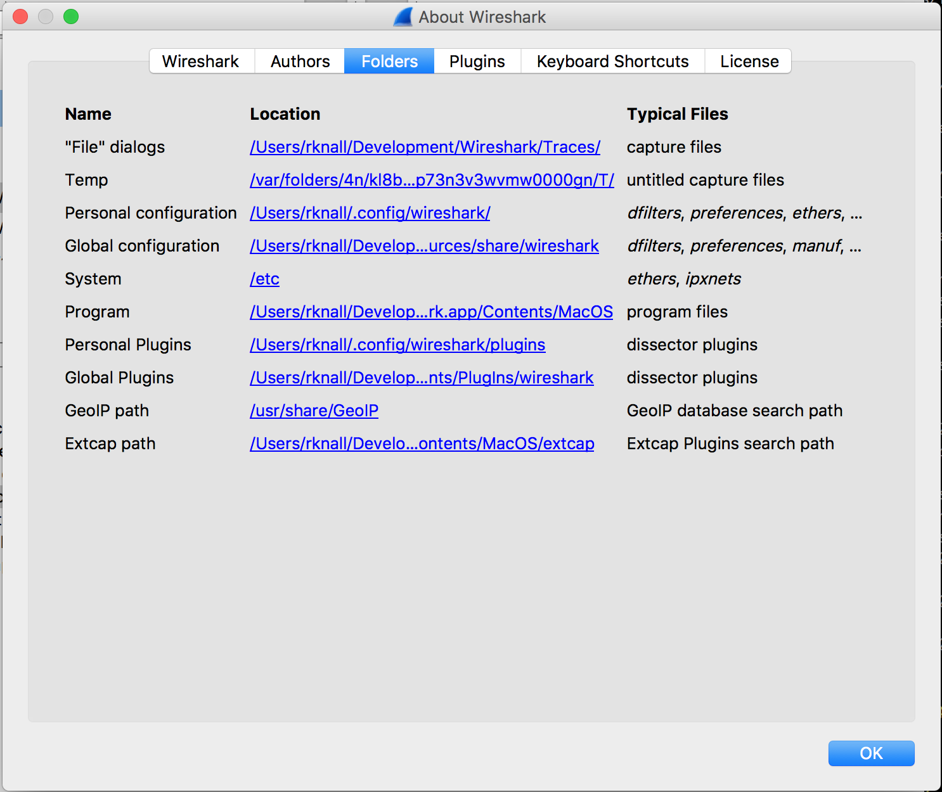
Locate the extcap Folder in Wireshark/Help
Only global folders available
Copy extcap_example.py there

Slide 20
Windows Users
Create batch script for execution
Command Execution does not evaluate shell scripts
Example in the header of extcap_example.py

Slide 21
Adapt the example
Let‘s take a look at
def extcap_capture(...)
Creates a pcap header
Encapsulates data in pcap block

Slide 22
C-Based extcap
Alternative: c-based extcap utility
extap/extcap-base.h
Handles all extcap managment stuff for you
Ensures correct and working extcap arguments
extcap/ssh-base.h
Handles ssh connections

Slide 23
About me?
Wireshark (well Etheral) Enthusiast since 2006
Core Developer since 2016
Working for B&R Industrial Automation on machine safety applications

Slide 24
Exported PDU
The Exported PDU function is basically a link layer type which allows you to add meta information to the packet and have a packet start at any protocol
level. Some other uses are:
Write decrypted packets
Write reassembled packets
Instead of User DLT no need to configure DLT.

Slide 25
Exported PDU
We can use Exported PDU and text2topcap to design test packets during dissector development. By using the Exported PDU tags to “send” the packet directly to the dissector which can be handy.
First we need to create the basic Exported PDU layer.

Slide 26
Crating basic packet
Put the following lines into a file
0000 00 0c 00 0c 67 73 6d 5f 61 5f 64 74 61 70 00 00 ..... gsm_a_dtap 67 73 6d 5f 61 5f 64 74 61 70
0010 00 1e 00 04 00 00 00 01 00 00 00 00 08 15 03
And run
text2pcap.exe -l 252 Manufacture_frames_exp_pdu.txt Manufacture_frames_exp_pdu.pcapng
EXPORTED_PDU
Tag: PDU content protocol name (12)
Length: 12
Protocol Name: gsm_a_dtap

Slide 27
Crating basic packet
Put the following lines into a file
0000 00 0c 00 0c 67 73 6d 5f 61 5f 64 74 61 70 00 00 ..... gsm_a_dtap 67 73 6d 5f 61 5f 64 74 61 70
0010 00 1e 00 04 00 00 00 01 00 00 00 00 08 15 03
And run
text2pcap.exe -l 252 Manufacture_frames_exp_pdu.txt Manufacture_frames_exp_pdu.pcapng
Tag: Original Frame number (30)
Length: 4
Original Frame Number: 1

Slide 28
Crating basic packet
Put the following lines into a file
0000 00 0c 00 0c 67 73 6d 5f 61 5f 64 74 61 70 00 00 ..... gsm_a_dtap 67 73 6d 5f 61 5f 64 74 61 70
0010 00 1e 00 04 00 00 00 01 00 00 00 00 08 15 03
And run
text2pcap.exe -l 252 Manufacture_frames_exp_pdu.txt Manufacture_frames_exp_pdu.pcapng
Tag: End-of-options (0)
Length: 0

Slide 29
Test packet
0000 00 0c 00 0c 6e 61 73 2d 35 67 73 00 00 00 00 00 ....nas-5gs.....
0010 00 1e 00 04 00 00 00 01 00 00 00 00 7e 00 3e 57 ..............>A Message type last octet 0x57 Authentication response
0020 78 00 57 0a 01 25 46 00 00 55 71 53 01 d6 10 04 ó....%F..UqS.Ö..
0030 8e 42 20 10 00 04 20 63 db 24 2f 04 4d aa 62 67 .B n.. cÛ$/.Mªbg
0040 52 22 04 78 78 00 33 78 00 30 00 5e 7b 78 40 04 R"."..0.nf.^{x@.
0050 75 9f 77 77 50 04 5a fa f6 6d b0 2b 03 3d ff ff u.wwP.Zúöm°+.=ÿÿ
0060 2c 04 00 00 00 00 2d 06 00 00 00 00 00 00 c0 7c ,.....-.......À|
0070 00 08 07 00 c0 7c 00 02 00 00 ....À|....
text2pcap.exe -l 252 Manufacture_frames_exp_pdu.txt Manufacture_frames_exp_pdu.pcapng

Slide 30
About me?
Work for Ericsson testing IMS systems.
Started with Wireshark(Ethereal) in 2003
Core developer since 2005
Made ~50 dissectors
GUI work on GTK2 and GTK3

