Slide 1
Mangling Packets on the Fly With Divert Sockets
How to Hack a Cisco Router ACL

Slide 2
Use Case
Connect to a server in your university dorm room from a class room to retrieve files. The university does not have a stateful firewall but uses router ACLs on the dorm network
Kary, turn the volume back down

Slide 3
Objective
Connect to a web server behind a router ACL
Caveat: You control the server and have made modifications to it

Slide 4
Is This Hacking?
I don’t know! But it’s cool n fun to do!

Slide 5
Things To Know
TCP Handshake
TCP Header Flags
Host Firewalls
Divert Sockets
Programming / Scripting
Cisco ACL Format
“Established” Keyword

Slide 6
ACL
access-list 101 permit icmp any any
access-list 101 permit tcp any any established
access-list 101 deny tcp any any

Slide 7
Established?
Denies packet if only the SYN flag is set
Let everything else in!
Is this correct? We’ll see

Slide 8
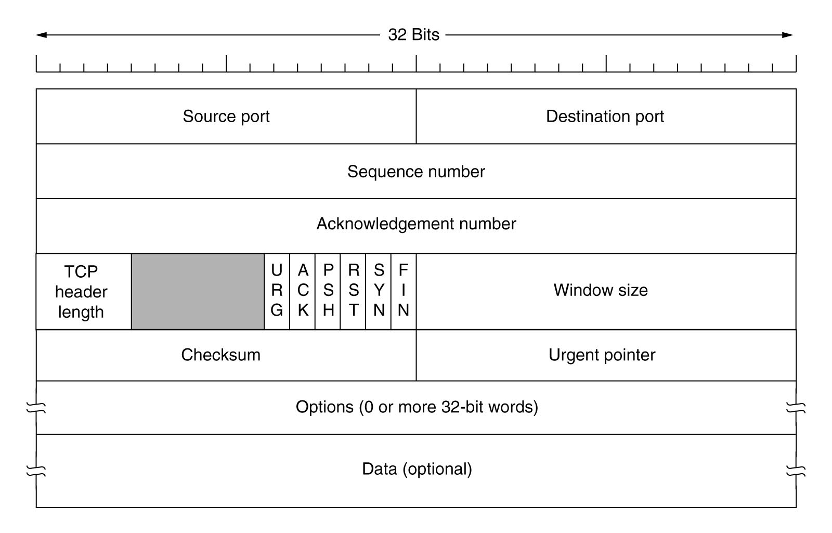
TCP Header

Slide 9
Testing
Demo with hping
Hping is a packet crafting cmd line utility

Slide 10
Objective
How are we going to get around the ACL?

Slide 11
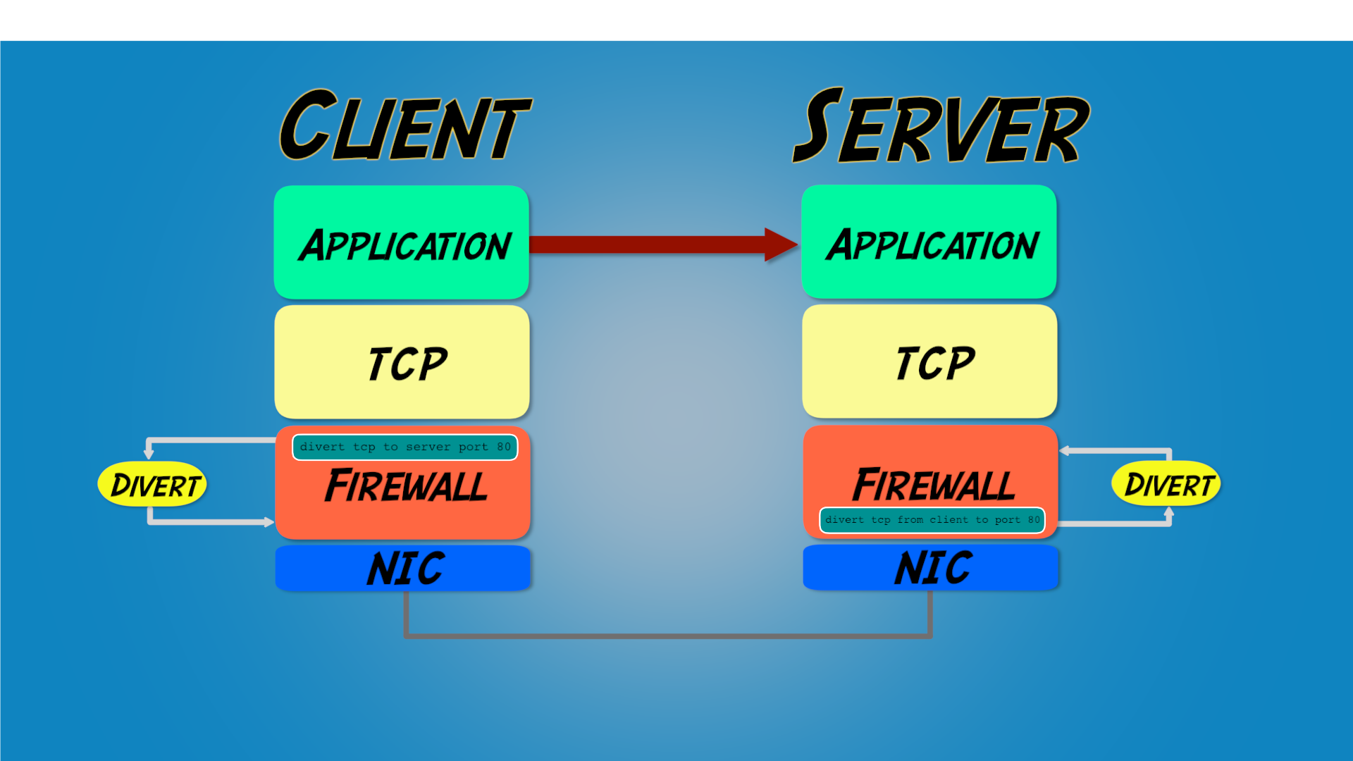
Divert Sockets

Slide 12
Divert Sockets
Bound to a local port
Program runs in user space
Big performance hit
Packets are redirected from host firewall
Packets dropped if nothing listening on port

Slide 13
Scripts
Client perl script
Check for SYN flag
Change to RST/ACK
Server perl script
Check for RST/ACK flags
Change to SYN

Slide 14
Web Server
Let’s make it happen!
We did it!

Slide 15
Q & A
Any questions?

Slide 16
Contact
Fill out the survey!
kary@packetbomb.com
@packetbomb
Packetbomb.com

