Slide 1
The Anatomy of a Cyber Attack

Slide 2
The preparation for A Cyber-Attack From Data gathering to implementation By: The Oldcommguy®
The Anatomy of a Cyber-Attack
CYBER WARFARE

Slide 3
The Cyber World
Areas of concern
Cyber Espionage
Cyber Warfare
Cyber Crime
Cyber Terrorism
Goals
Cyber Knowledge
Cyber Protection
Recognition and Mitigation of attacks

Slide 4
Targets and Motives
Corporate
Types - DOS – SYN – ICMP – Port – DNS –
Trojans #1 attack and access method – over 79%
Thief –
Personnel info
Corporate info
Defacement
Takeover/control
Financial (directly)
Extortion
Revenge
Corporate or personnel image and reputation
Individual/Personal – Yours and Family - entire Life
.............
Governmental/Military
Secrets
Weapon Control
Political, Religious……

Slide 5
Goals of Cyber - attacks
Money
Power
Control
Publicity
Revenge
Crackers
Learning
Future protection/Penetration testing
Or Just to do it!

Slide 6
Data and data sources
Intelligence
Intelligence is lots of data –small pieces add up
Male/female
Initials to real name
Address
Residence
Work history
Type of system used
Weaknesses
Where do you get data
Social networks
Stolen items –RFID’s, laptops, wallets, papers(trash)
Shoulder surfing – looking over someone's back
Phishing
Personally from employee or target person, internal mole
,

Slide 7
What is needed for a cyber attack
Goal – Reason for attack – end desire
Intelligence
Lots of data
Information
Five steps in an attack
Reconnaissance
Probing
Actual attack
Maintaining presence
To continue original attack desired effect
To allow for future attacks
continued surveillance
Light footing
Covering attack track
How it was done
Access point
Residual for future or continued access

Slide 8
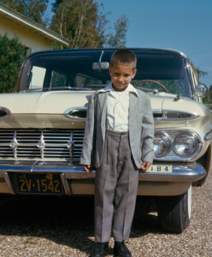
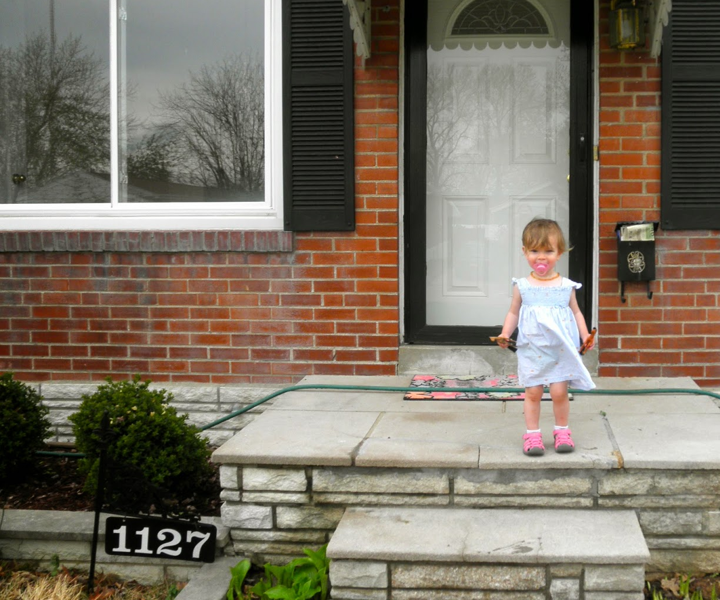
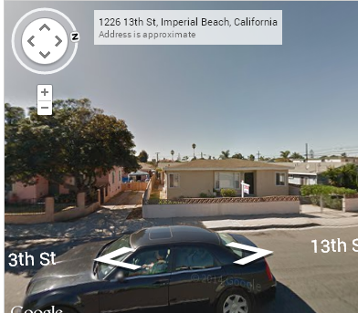
Information – many sources

Slide 9
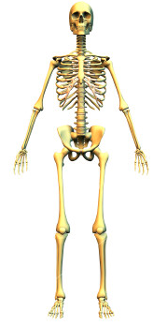
Hooking the bones together! Small easily found data!
Small things hook big part together
Ligaments for human bones
Data for the cyber anatomy of the target
Little items lead to big information
A family member
A phone number
A license plate
House street, number
Travel info
Pet info, friends info….etc
More small pieces of info – best place to eat

Slide 10
Data for Personal attack
The Eight piece puzzle for personal ID thief
Full Name
Including Spouse full info
Address
Current
Last known
Dependents and ages
Birth dates
Phone Numbers
Education
High School
College
Trade
E-mail – already hacked
Current employee
Any of theses –
Social security – Drivers license – DOB and place – Hobbies – Family info
* the average CV/resume contains all of these

Slide 11
Data and info source tools
Why not attack the server and clients
Tools for Inside and outside exploits/data
Nmap – Top line scanner and exploit viewer
Nessus – Access Scanner
Nikto 2 – Web Scanner
Scripts as well as most applications
Armitage – Metasploit tool – good and bad
Hashcat – Password digger
WiFite – Wireless configuration tester
Wireshark – packet capture and analyzer
T-Shark – automated
With SNORT
SET – Social Engineering Toolset
Easy to use Human attack tool kit
MANY MORE – focused to general
OWASP, pMap, WIFI password dump, iSafe Keylogger, AFF…etc
Estimate over 1000 different tools for any OS
More to exploit Internet places – Facebook, Linkedin…..etc

Slide 12
Attack data and access sources
Old Media attacks
Café wifi
School networks
Guest networks at corporations
Airplane and airport wifi
New targets
3 and 4 G networks
Public WLANs
Corporate tunnels
The cloud
WiFi everywhere
Cell phone and tablet platforms
WLAN’s
Physical attacks - Botting - Keyloggers - BIOS - Firmware
BACKDOOR – Intel and Apples access
Stupidity!
DO NOT RULE OUT – PHYSICAL ACCESS
-

Slide 13
Trickery everywhere
Malicious Websites
Grow at an annual rate of 110 to 125%
Up to 70% of legitimate sites have some sort of malware or redirects on them
50+% of top 100 sites have some sore of malicious activity
In 2010 the site - pc-optimizer.com was #1 for code thief
Any free fix your PC is dangerous
USA has over 28% bot netted computers
South Korea is second
Aladel.net house over 56,000 current threats
Record is 227,000 trojans
Many compromised sites use a google name format
i.e. goooogleadsence.biz
58 of the sites listed among Alexa's top 25,000 most popular websites are delivering drive-by downloads of malicious code, potentially affecting millions of users each day.
Alexa top-ranked domains served malicious content 23 (or 79 percent) of the days in February," the report says." That means this problem is not isolated and occurs on a continuous, regular basis."

Slide 14
Problems
Four Top Trends in cyber world
Increase in Business Networks complexity
Bigger networks
Lack of visualization to recognize attacks and ploys
Less trained network employees
Increasing criminal Motivation
More money on the net
Increasing commoditization of weapon focused software
Hack for pay
Tools to hack for pay
Including specialized attack methods and support
Lack of user knowledge
More users
More access methods
No training
IPv6 or more accurately the push to transition from IP Before

Slide 15
Cyber Warfare – Enemies and targets
Top enemies – Espionage – Attacks - Communications
China, Iran, North Korea
country sponsored and organized terrorism
Islamic terrorists and others
Recruitment
Training
Coordination of attacks
Thrill seekers and for hire threats
Political sympathizers for radical causes
Recruitment
Training
Message marketing
Targets
Nuclear plants
Any automated production including Gas, oil…etc
SCADA is a hot target – Low tech and isolation has been its best protection
Military
Monetary system
Citizen communications platform
Internet
Cell
Emergency services

Slide 16
Types of Cyber - attacks
Types of Warfare attacks
Combination of any and all
Cyber and Physical
Nuclear
Military Command and control
Turn our weapons on us
Confusion
Social attacks
Monetary
Stock markets
Brokers
Federal Reserve
Banks
Probe attacks for potential all out warfare
One day they shut down everything
No money, no food production, no oil, no natural gas, no power
NO COMMUNICATIONS – TV, Radio, phones, cell, satellite
We have no back up communications
No POTS – Ham radio MAY be the only long range communications platform

Slide 17
Review
The Anatomy of an attack
Rational and reason for an attack
Just $
Revenge…etc
Lots of data gathering leads to information leads to Intelligence about target or targets
To gain focus
Small probing attacks
Vulnerability check
Network, Servers, Applications, Users
Final Plan
Target
Method
Outside influences
The Attack
Small nibble
Persistent threat
All out Cyber Attack
Cyber and Physical
The retreat plan
All out with no trail or diversion trail
Back door or other malware let behind
Knowledge of weaknesses
The future attack plan or drain of information, money or access to a deeper attack

Slide 18
Issues for you to solve
Ignorance of technology vulnerability
Chaos and confusion – Mob mentality
Hunger for more technology
Google Glasses
Wrist tool
Automobile computers…etc
The more we have, the more we rely on it, the more vulnerable we become!
We want to trust the technology but cannot
CANNOT trust any site, access or person
We act on emotion not thought
We cannot see the danger
Anti Virus protection is about 35% effective unless updated daily and then only 75%
We are arrogant about what we want to do
No or little compliance by businesses
Target…et. al.
We seem not to learn from the past
IPv6 – the future or not?

Slide 19
The End or is it?
The reality is that we will be attacked – Not IF but When!
There is no real end in sight, as long as there are cyber criminals, warriors and attacks!
The future will be 100% CYBER WARFARE in all of its forms!
Smile!

